Slide 1
Stroke Risk Prediction with Regression Model
Student Name: Görkem GÜZEL
Student ID: 040170219

Slide 2
Contents
1) Data Preprocessing
2) Exploratory Data Analysis
3) Feature Engineering & Regression Model
4) Predicting and Grouping Outcome
5) Summarization

Slide 3
1) Data Preprocessing
I wanted to do a project related to medicine and while searching for datasets I came across the “Stroke Prediction Dataset”. With this dataset I decided to create a regression model in order to group people by stroke risk.
a) Getting the Dataset
I downloaded the dataset from this Kaggle page. Data contains 5110 observations with 12 attributes.
b) Importing Libaries
The libraries I used are “Pandas” and “Sci-Kit Learn”
c) Data Cleaning
ID doesn’t have anything to do with results, unknown smoking status doesn’t provide any info for adults and gender values labeled as other don’t affect the outcome since only gender at birth can affect the result. So, I deleted mentioned columns from dataset.

Slide 4
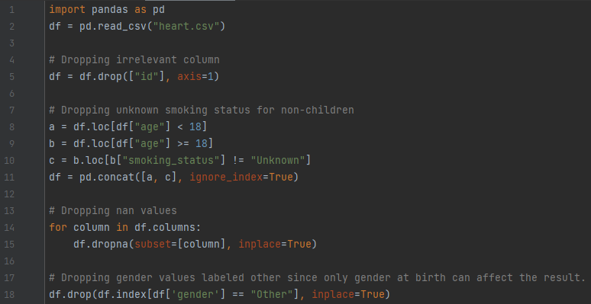

Slide 5

2) Exploratory Data Analysis
After previous piece of code, remaining attributes are
At this point, correlation test is needed to be run in order to determine which attributes to use in model.
In order to run the correlation test, string values must be converted to integers. I used the dictionary method to do so.

Slide 6
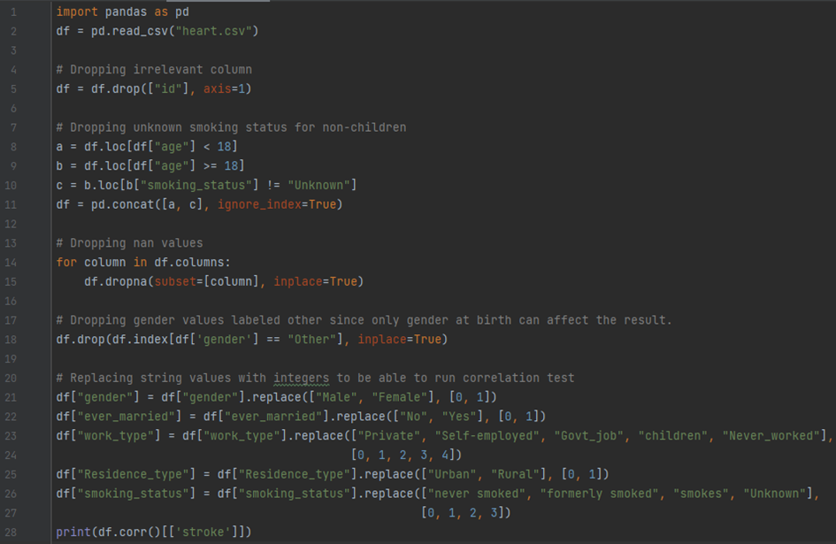

Slide 7
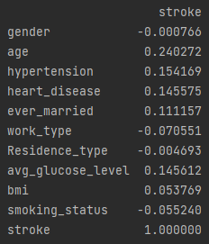
According to the results below, I decided on using attributes with higher than 0.05 correlation score and subsequently I removed “gender” and “Residence_type” columns.

Slide 8
3) Feature Engineering & Regression Model
I tried to built the interface as user friendly as possible with using while loops. This way in case of an invalid input, program doesn’t crash and returns to the previous step therefore it makes user able to enter a valid input. I also added an info screen.
Since a considerable amount of people doesn’t know the average glucose level in their blood I added an option as unknown, therefore the need of two different models, one with AGL value and one without, arised. Therefore, I defined functions called as conversion and regression to save on code length.

Slide 9
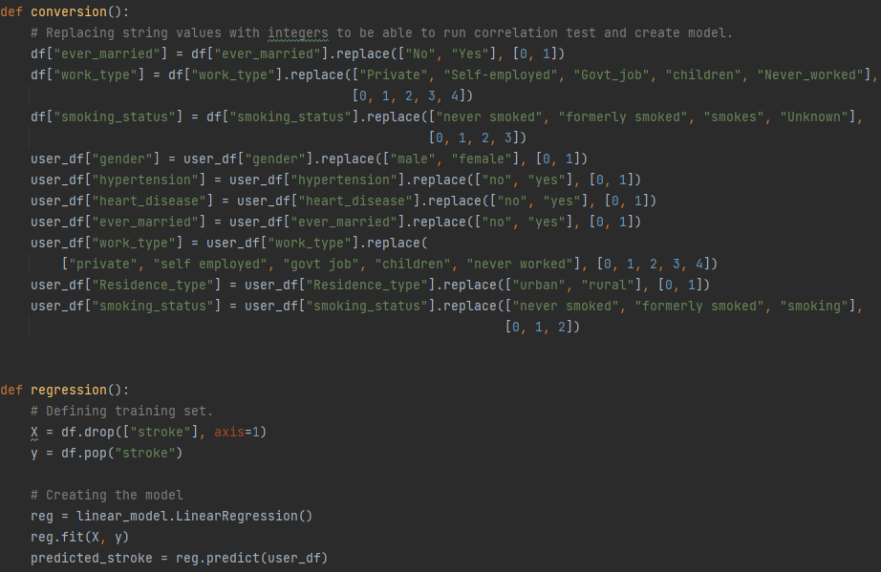

Slide 10
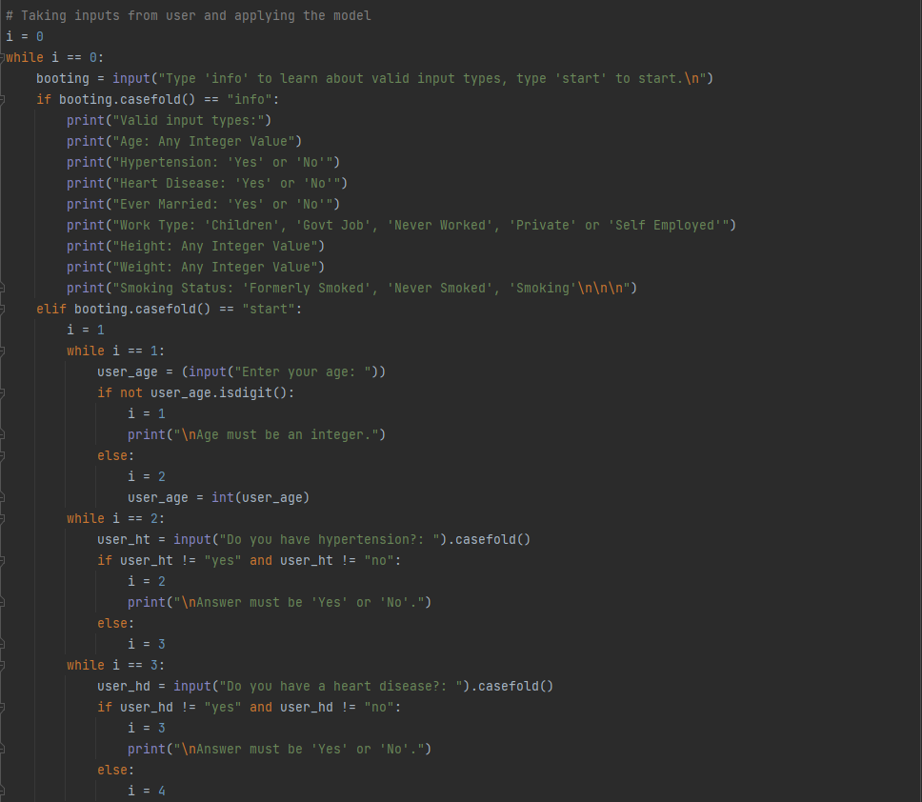
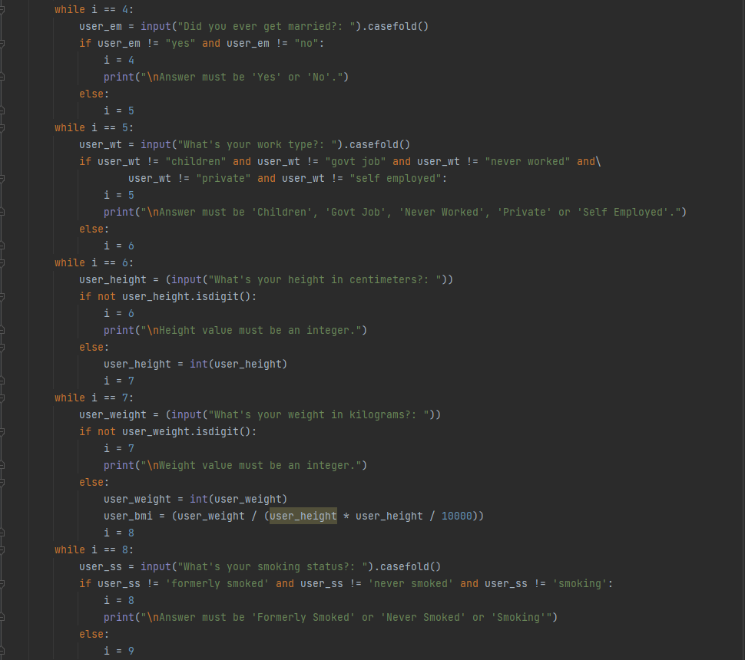

Slide 11
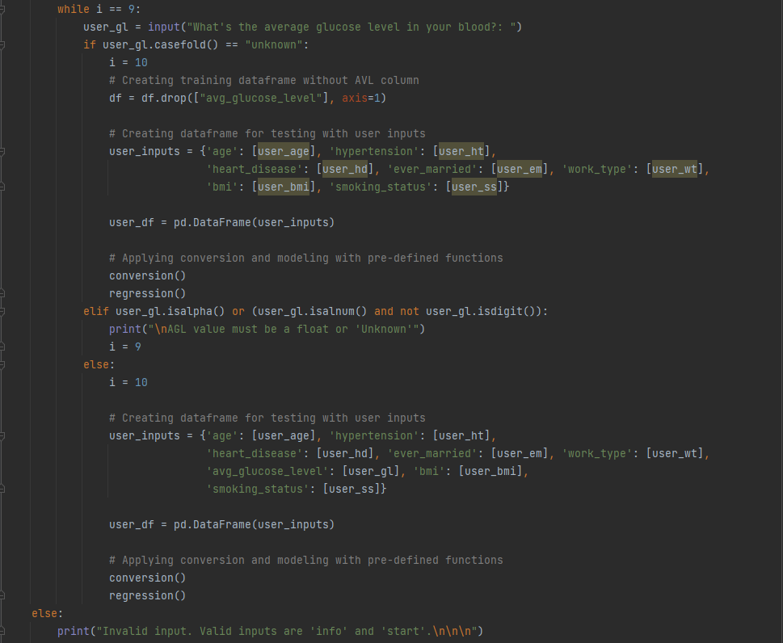

Slide 12
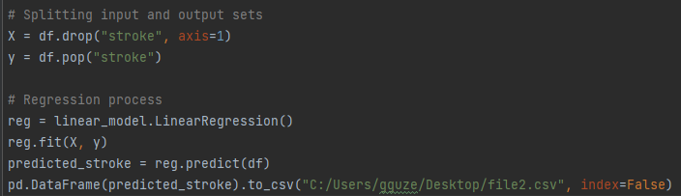
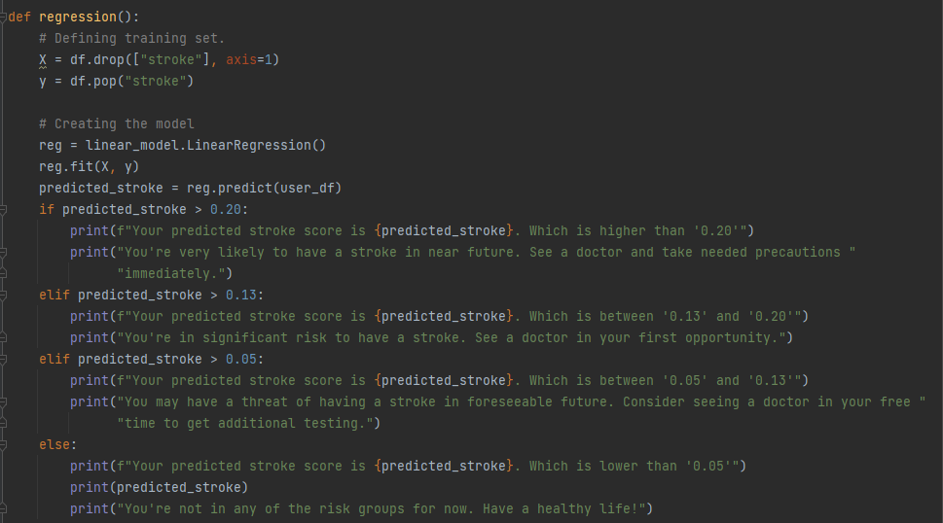
4) Predicting and Grouping Outcome
I took an output of prediction values for all of the data and compared it with the number of people that had stroke. After the comparison, I came out with following groups

Slide 13
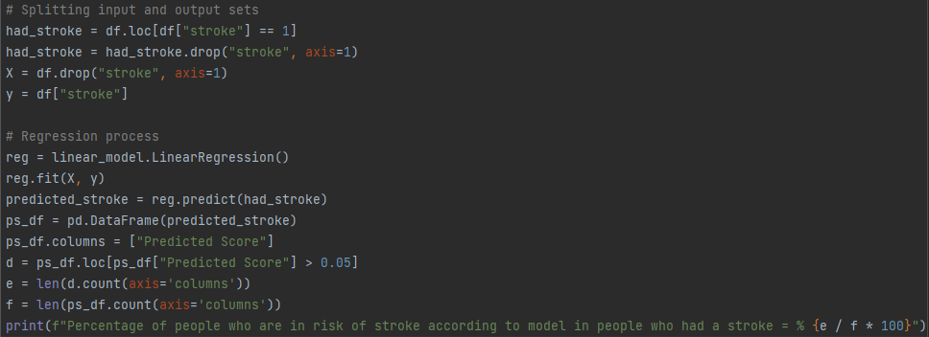
As an accuracy test, I calculated the percentage of people who are in risk of stroke according to model in people who had a stroke.
And it yielded

Slide 14
5) Summarization
I built a program which takes input from the user and tells the risk of having a stroke, I grouped the outcomes in three risk groups, among 181 people who suffered a stroke in the cleaned dataset, 162 of them are in a risk group. This sets the accuracy at %89.5.

